Slide 1

Travelling Salesman Problem
"Optimizing Routes, Minimizing Costs"

Slide 2

Group - 7
Group Members

Slide 3
Introduction:
What is travelling salesman problem?
→ The Traveling Salesman Problem (TSP) is a classic problem in optimization and operations research. It involves finding the shortest possible route for a salesman to visit a set of cities exactly once and return to the starting point. The challenge is to determine the most efficient way to travel among these cities to minimize the total travel distance or cost.
→ The goal of the Traveling Salesman Problem (TSP) is to find the "cheapest" tour of a select number of "cities" with the following restrictions :
Have to visit each city once and only once
Have to return to the original starting point

Slide 4
Explanation of the Algorithm :
The Traveling Salesman Problem (TSP) is a well-known optimization problem in which a salesman needs to visit a set of cities exactly once and return to the starting city, aiming to minimize the total travel distance or cost.
How It Works:
Starting Point: The salesman begins at a specific city.
Visit All Cities: The goal is to visit each city exactly once.
Return to Start: After visiting all cities, the salesman must return to the starting city.
Optimize Route: Among all possible routes, the task is to find the one with the shortest total distance or lowest cost.
Why We Use TSP:
Efficiency: It helps in minimizing travel distance and cost, which is crucial in logistics and transportation.
Optimization: Ensures the most efficient use of resources, such as fuel and time.

Slide 5
Real Life Applications
Logistics & Delivery : Helps delivery companies plan the most efficient route for drivers.
Manufacturing & Robotics : Used to optimize the paths robots take while working in factories.
Microchip Production : Optimizes the path for tools in electronics manufacturing.
Route Planning : Used in transportation, like planning the best routes for public transport or taxis.

Slide 6
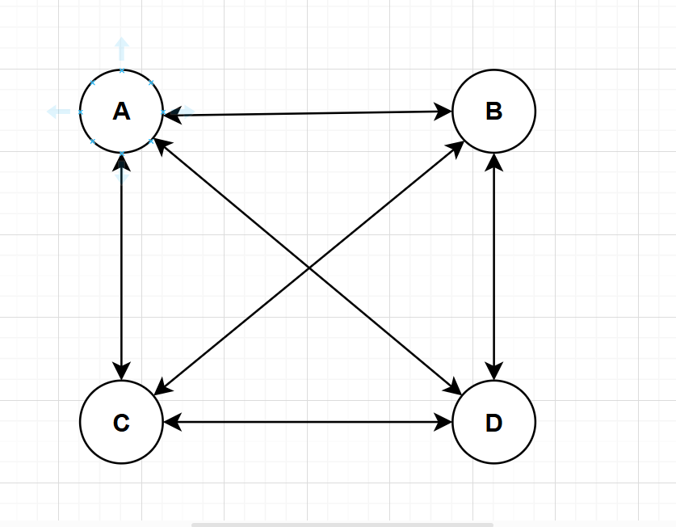
Graphical Representation :

Slide 7
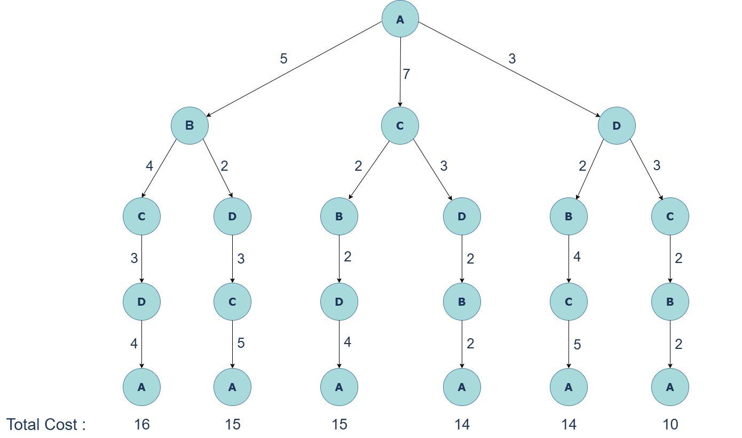
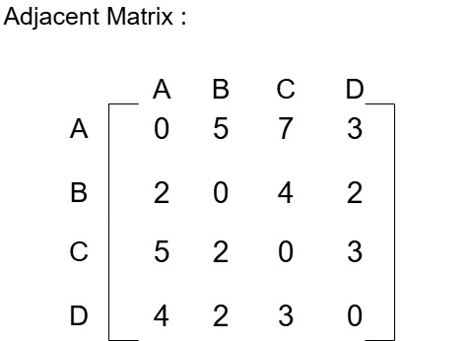

Slide 8
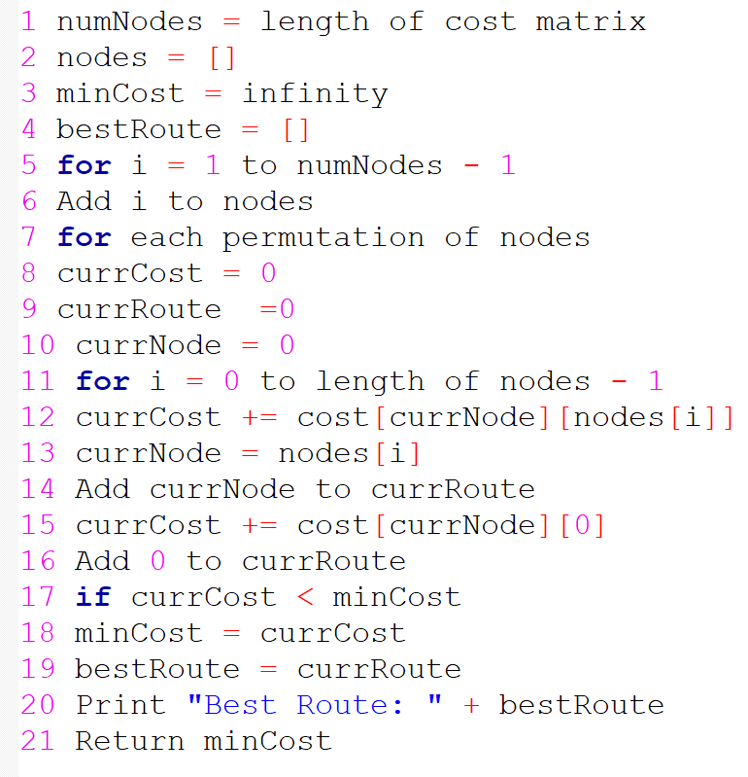
Pseudocode
Analysis of Complexity
(1-4) O(1)
O(n)
O(n-1)
For one permutation
For all permutation
O(n.(n-1)! )
O(n-1)=O(n)
O((n-1)!)
O(1)

Slide 9
Analysis of Complexity
Overall Time Complexity:
The dominant term comes from iterating over all permutations and calculating the cost for each one, which is:
O(n. (n-1)!) = O(n!)
Here n is the number of nodes (cities). This is because the algorithm checks every possible permutation of the cities and calculates the total cost for each one.

Slide 10
Code :
#include <iostream>
#include <bits/stdc++.h>
using namespace std;
// Function to get the name of a city given its index
char getCityName(int index) {
return 'A' + index;
}
int tsp(vector<vector<int>> &cost) {
// Number of nodes
int numNodes = cost.size();
vector<int> nodes;
// Initialize the nodes excluding the fixed starting point (node 0)
for (int i = 1; i < numNodes; i++)
nodes.push_back(i);
int minCost = INT_MAX;
vector<int> bestRoute;

Slide 11
// Generate all permutations of the remaining nodes
do {
int currCost = 0;
vector<int> currRoute = {0}; // Start from node 0
int currNode = 0;
// Calculate the cost of the current permutation
for (int i = 0; i < nodes.size(); i++) {
currCost += cost[currNode][nodes[i]];
currNode = nodes[i];
currRoute.push_back(currNode); // Add node to the current route
}
// Add the cost to return to the starting node
currCost += cost[currNode][0];
currRoute.push_back(0); // Complete the cycle by returning to node 0
// Print the current route and its cost
cout << "Route: ";
for (int i = 0; i < currRoute.size() - 1; i++) {
cout << getCityName(currRoute[i]) << " --> ";
}
cout << getCityName(currRoute[currRoute.size() - 1]) << " ";
cout << " || Cost: " << currCost << endl;
// Update the minimum cost if the current cost is lower
if (currCost < minCost) {
minCost = currCost;
bestRoute = currRoute;
}

Slide 12
} while (next_permutation(nodes.begin(), nodes.end()));
// Print the best route and the minimum cost
cout << "\nBest Route: ";
for (int i = 0; i < bestRoute.size() - 1; i++) {
cout << getCityName(bestRoute[i]) << " --> ";
}
cout << getCityName(bestRoute[bestRoute.size() - 1]) << " ";
return minCost;
}
int main() {
vector<vector<int>> cost = {{0, 5, 7, 3},
{2, 0, 4, 2},
{5, 2, 0, 3},
{4, 2, 3, 0}};
int res = tsp(cost);
cout << "\nMinimum Cost: " << res << endl;
return 0;
}

Slide 13
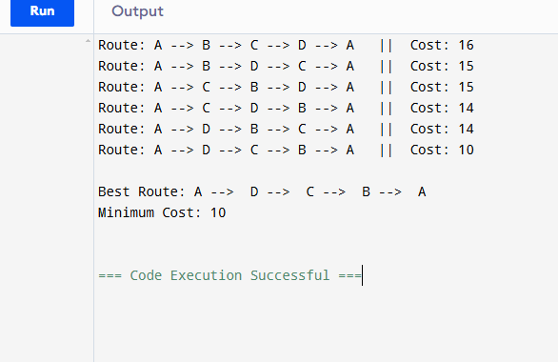
Output of the Code:

Slide 14
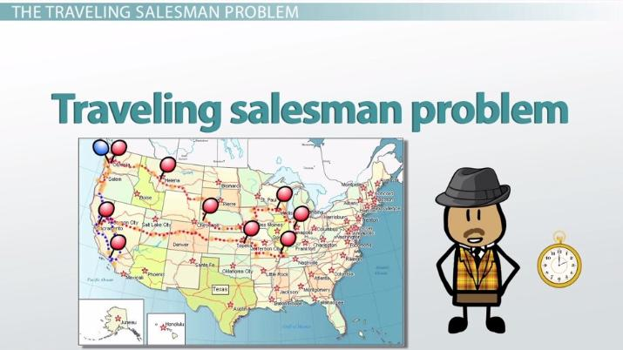
Thank You
- - s question?
- Any Question?

